Slide 1

PowerShell 7
Released: March 4th 2020
PowerShell Team, Microsoft

Slide 2
Objectives
Where PowerShell has been
What PowerShell 7 is all about
The latest and greatest features from the PowerShell Team
What is coming next
Contribute to PowerShell’s continued development

Slide 3
Windows PowerShell
Monad Manifesto - 2002
Built on .NET Framework
PowerShell 1.0 - 2006
PowerShell 2.0 – 2009
PowerShell 3.0 – 2012
PowerShell 4.0 – 2013
PowerShell 5.0 – 2016
PowerShell 5.1 - 2016
Windows (exclusive) Management Tool

Slide 4
Windows PowerShell
PowerShell Core
PowerShell built on .NET Core
PowerShell Core 6.0 – Jan 10th, 2018
PowerShell Core 6.1 – Sept 13th, 2018
PowerShell Core 6.2 – March 28th, 2019
Cross-platform
Run in whatever environment or OS makes sense for you
Self-contained and side-by-side
“No reboot” installation
Universal management platform independent of your OS
Open-source
Direct line to the PowerShell team
Share the collective contributions of the PowerShell community
Monad Manifesto - 2002
Built on .NET Framework
PowerShell 1.0 - 2006
PowerShell 2.0 – 2009
PowerShell 3.0 – 2012
PowerShell 4.0 – 2013
PowerShell 5.0 – 2016
PowerShell 5.1 - 2016
Windows (exclusive) Management Tool

Slide 5
Windows PowerShell
PowerShell Core
PowerShell 7
PowerShell built on .NET Core
PowerShell Core 6.0 – Jan 10th, 2018
PowerShell Core 6.1 – Sept 13th, 2018
PowerShell Core 6.2 – March 28th, 2019
Cross-platform
Run in whatever environment or OS makes sense for you
Self-contained and side-by-side
“No reboot” installation
Universal management platform independent of your OS
Open-source
Direct line to the PowerShell team
Share the collective contributions of the PowerShell community
PowerShell built on .NET Core 3.1
Cross-platform
Run in whatever environment or OS makes sense for you
Open-source
Direct line to the PowerShell team
Share the collective contributions of the PowerShell community
Tool for cloud/hybrid environments
Full Windows Management Tool
Viable full Windows PowerShell Replacement
Monad Manifesto - 2002
Built on .NET Framework
PowerShell 1.0 - 2006
PowerShell 2.0 – 2009
PowerShell 3.0 – 2012
Powershell 4.0 – 2013
PowerShell 5.0 – 2016
PowerShell 5.1 - 2016
Windows (exclusive) Management Tool

Slide 6

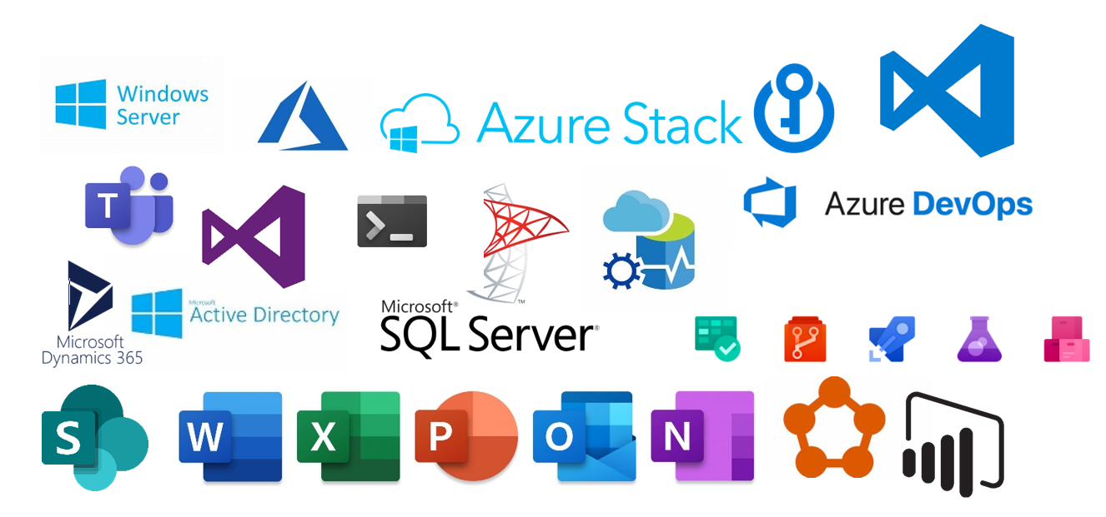
The Power of the Shell
PowerShell enables you to manage and automate your servers, clouds, hypervisors, networks, and much more!

Slide 7
PowerShell 7
Released: March 4th 2020
PowerShell Team, Microsoft

Slide 8

PowerShell Core Usage

Slide 9
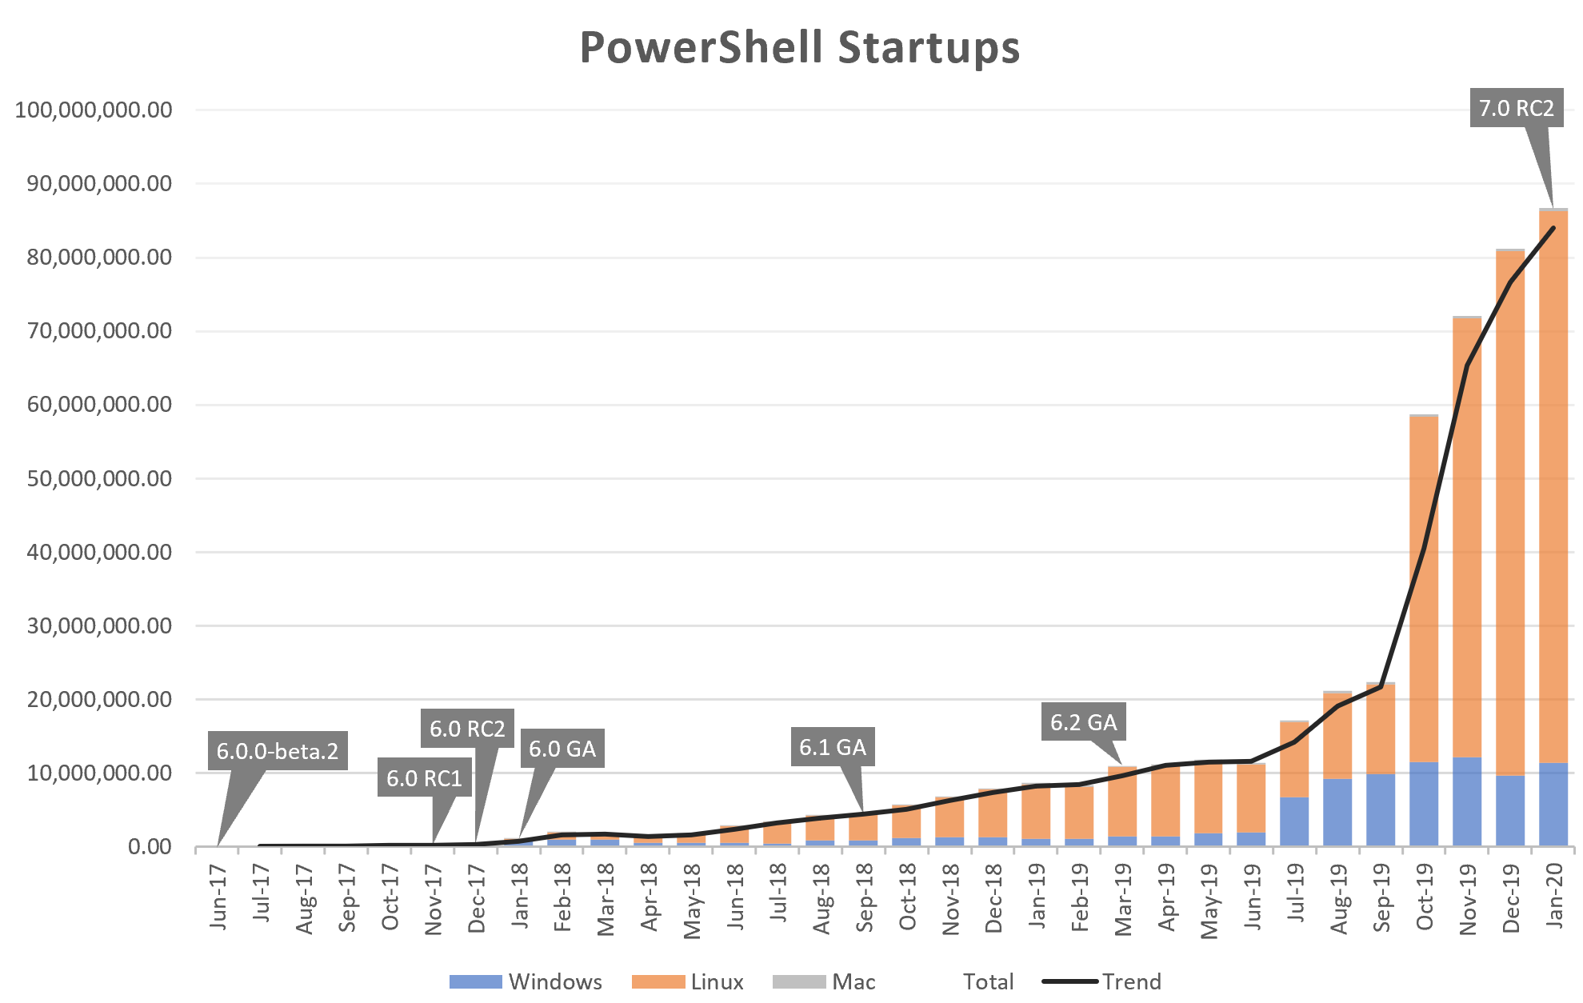
PowerShell Core Usage

Slide 10
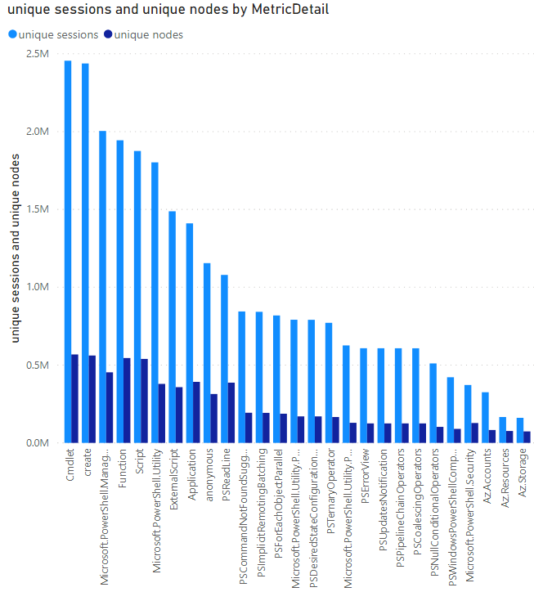
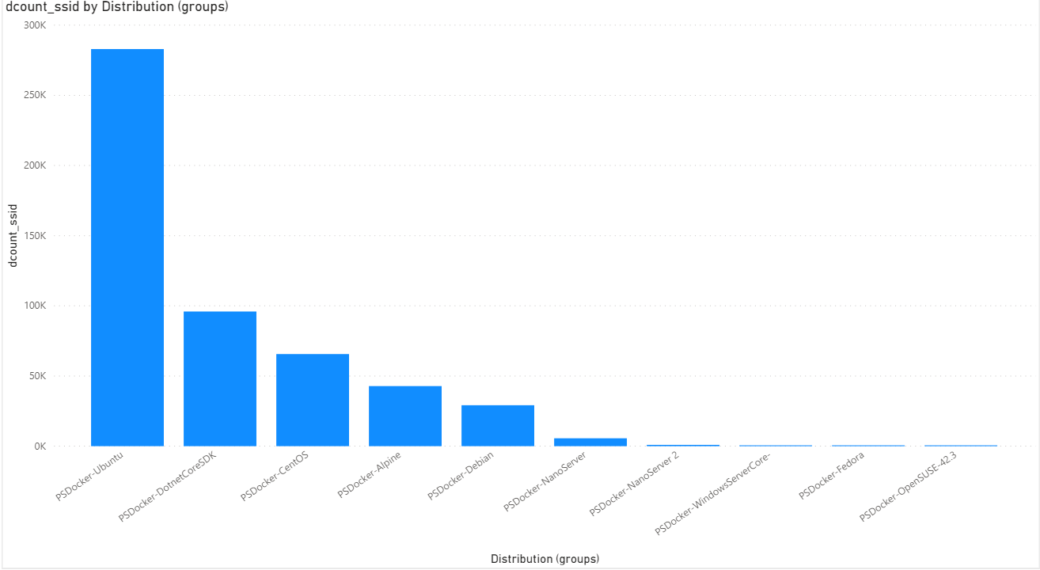
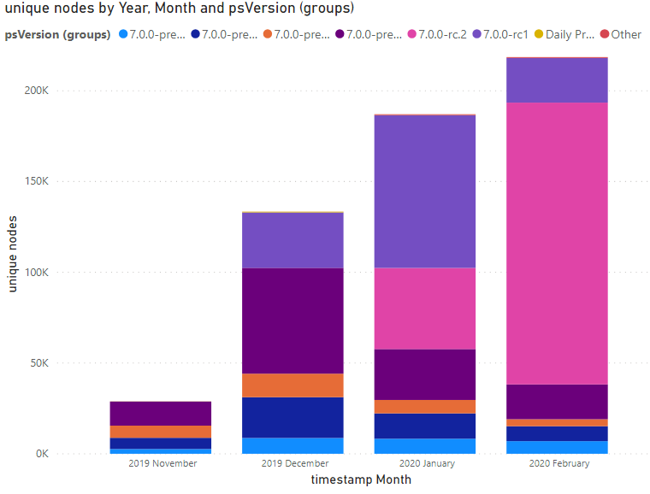
PowerShell 7 Telemetry
aka.ms/PSGitHubBi

Slide 11
PowerShell 7
Released: March 4th 2020
PowerShell Team, Microsoft

Slide 12
PowerShell 7
PowerShell built on .NET Core 3.1
Long-term servicing for ~3 years
Improved performance
Secret / credential management
Invoke-DscResource
ForEach-Object -Parallel
Better backwards compatibility with Windows
Windows PowerShell wrapper for Import-Module
Group Policy support
Ternary operator ( a ? b : c )
New error views and Get-Error
New version notification
Pipeline chain operators ( || and && )
Null conditional operators ( ?? and ??= )
Windows compatibility
What is it?
New scenarios
Delighters

Slide 13
New operators
Ternary ( a ? b : c )
Pipeline chain ( && and || )
Null-coalescing ( ?? and ??= )

Slide 14
ForEach-Object -Parallel
Enables parallel execution of a pipeline
Use cases include
Extracting logs from multiple endpoints
Querying/manipulating multiple database endpoints
Executing synchronous REST calls in parallel
-ThrottleLimit parameter for setting ceiling on runspaces at one time
Leverages ThreadJob module to manage runspaces
No need to use this with PowerShell Remoting

Slide 15
New Error Views
This feature adds a ConciseView where most commands return just the relevant error message.
In cases where there is additional contextual information in a script file or the location in a script block, you get the line number, the line of text in question, and a pointer to where the error occurred.
We also added a new cmdlet
Get-Error to get much richer information on errors.

Slide 16
Windows Compatibility Update
Native compatibility
Improved module compatibility from 65% in Server 2019 to 85%
Continuing to improve as .NET adds back Windows APIs
Highlights include PKI, TLS, and BitsTransfer
Legacy mode
Automatically called for incompatible system32 modules
Import-Module –UseWindowsPowerShell
Creates a Windows PowerShell runspace for each PS 7

Slide 17
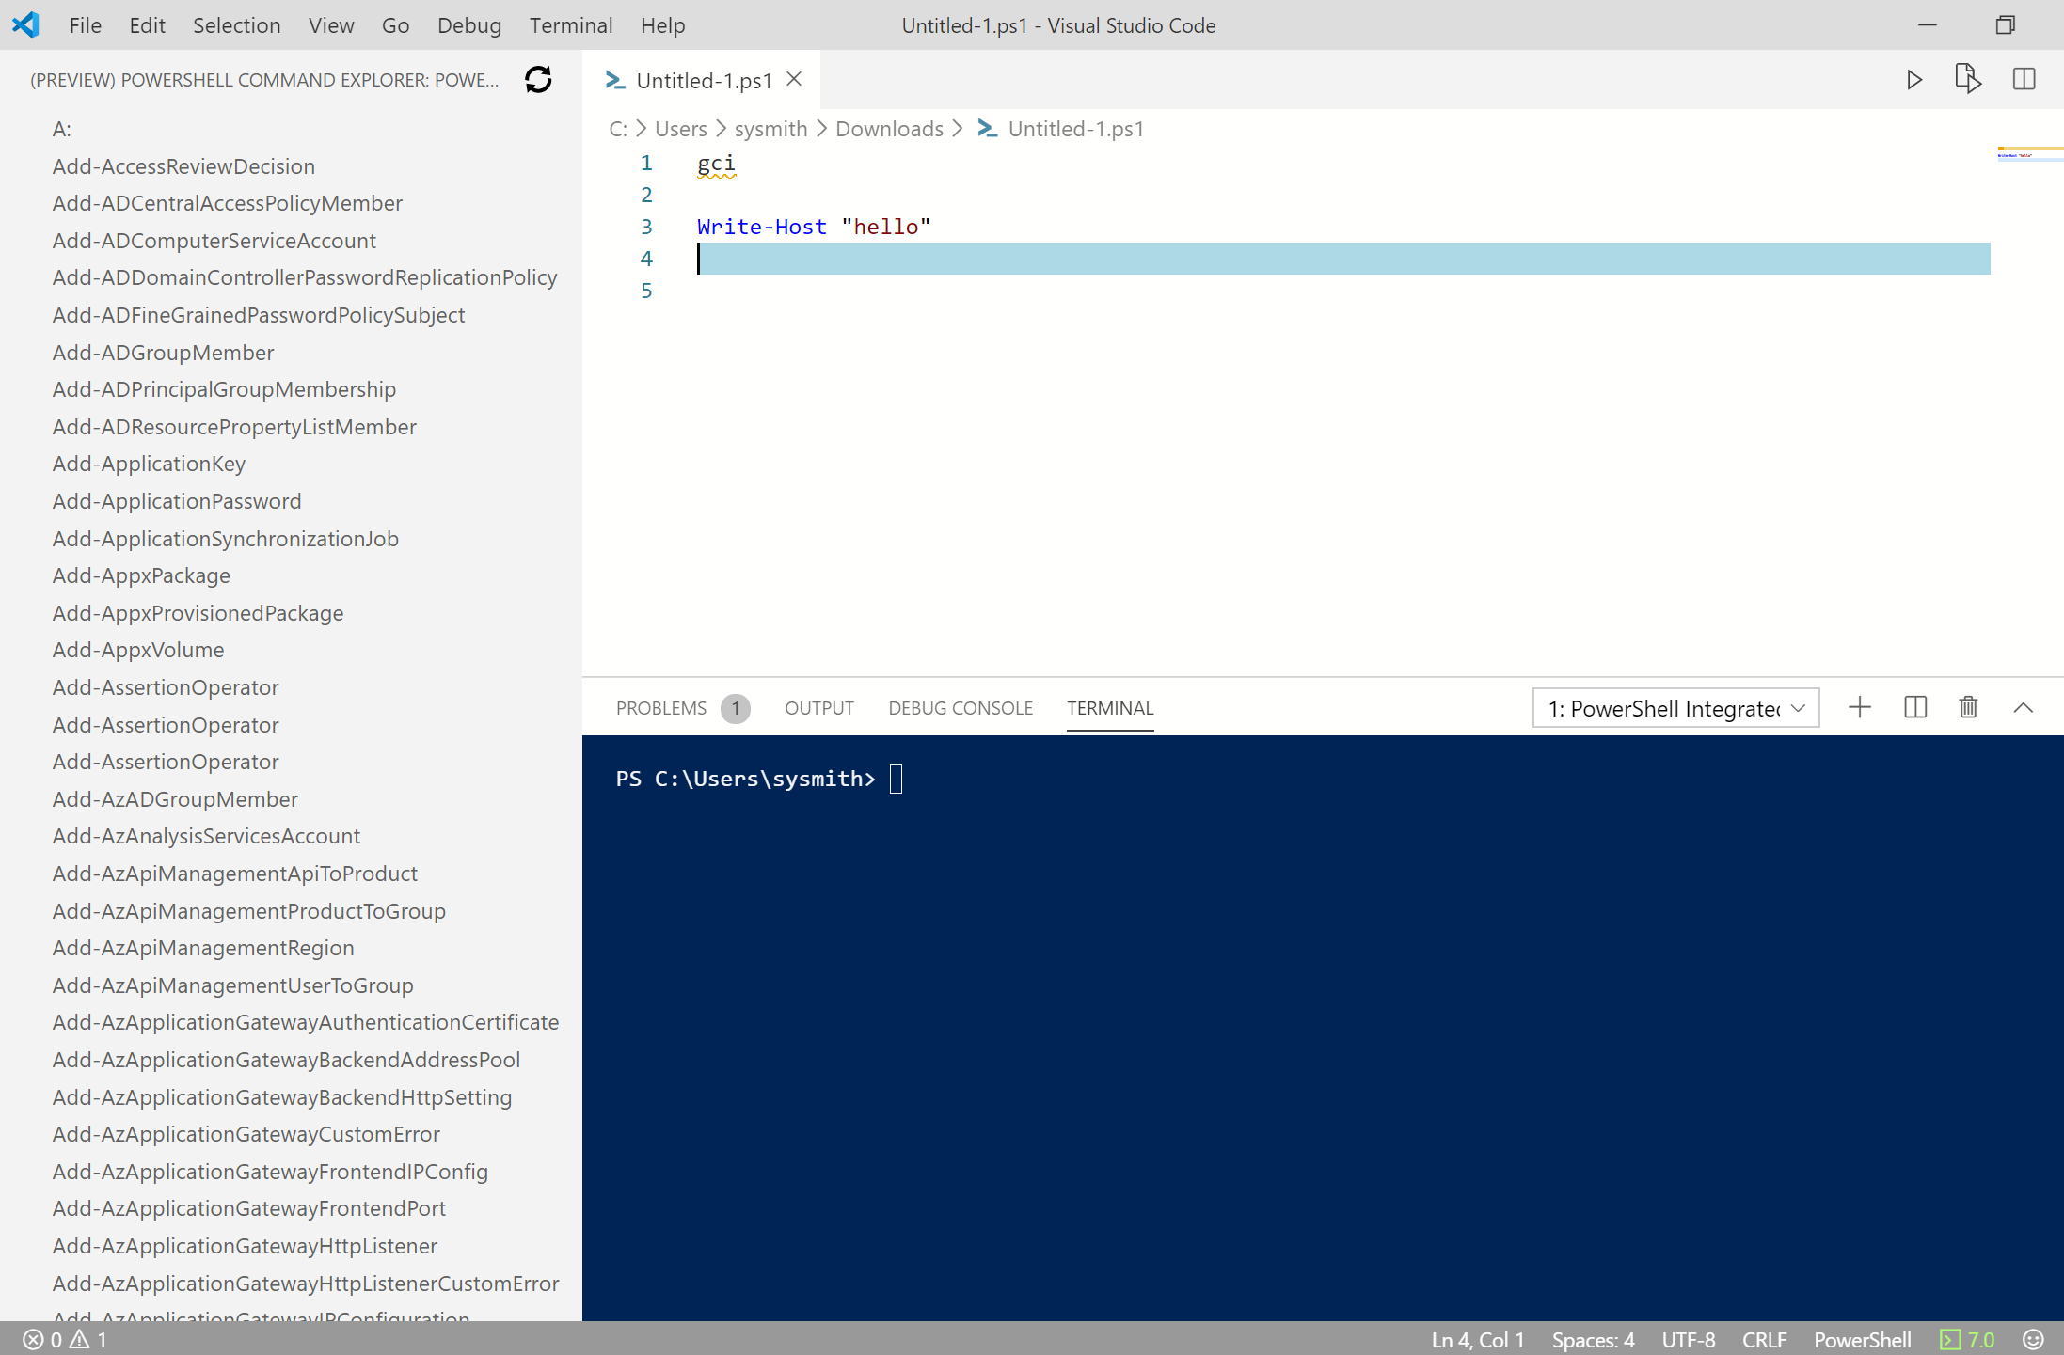
PowerShell Extension for VSCode
Major Performance improvements
Full PSReadLine support
ISE Mode

Slide 18
What’s next?
Will continue to keep pace with .NET (5 and beyond)
Improve the ease of deployment/installation of PowerShell 7
Investigating more package technologies
Increase native module compatibility
Investigations into PSReadline improvements
Improvements to native command execution
Secrets Management
Tell us what you care about!
File and 👍 issues

Slide 19
Call to Action
Upgrade to PowerShell 7!
Get started with VSCode and the PowerShell Extension
If you can’t upgrade, tell us why by filing an issue
Contribute to open-source projects
PowerShell
Editor Services and the Visual Studio Code extension
Script Analyzer
Documentation
Join the PS Community Call the 3rd Thursday of every month

Slide 20
Thanks for joining!

